Slide 1
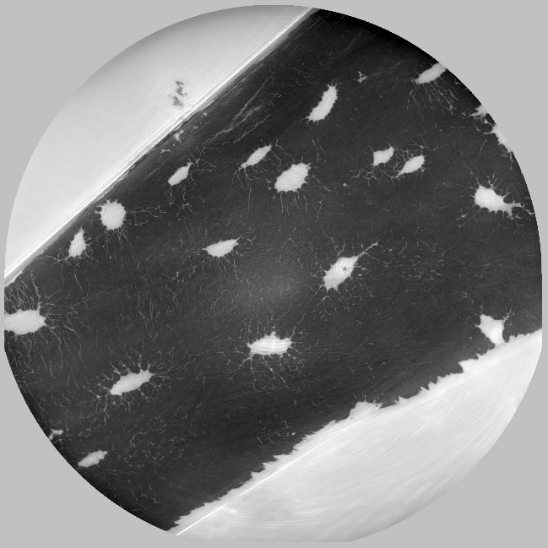
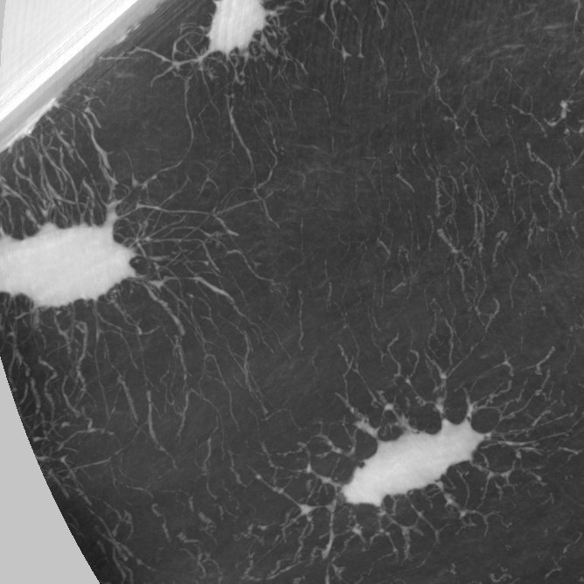
Phase nano-CT
Sample #166, 56 yo
Voxel 120 nm
MIP-Z 100 slices
Zoom of MIP-Z

Slide 2
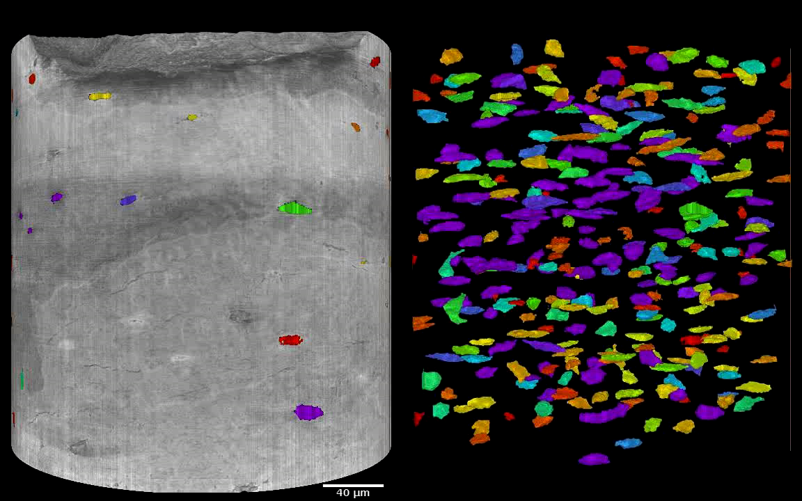
Images at 120 nm: segmentation of lacunae
Segmentation of lacunae

